Slide 1
Randomized Phase II Trial Comparing the Efficacy and Safety of Nintedanib Versus Sorafenib in Caucasian Patients With Advanced Hepatocellular Carcinoma
Abstract 238
Palmer D, Ma JT, Radosavljevic MP, Ross P, Graham J, Fartoux L, Deptala A, Wenz A, Hocke J, Loembé A-B, Meyer T

Slide 2

Learning Objectives
To describe the potential of nintedanib for the treatment of advanced HCC
To evaluate the efficacy of nintedanib versus sorafenib, the standard systemic therapy for advanced HCC, in this phase II trial
To compare the safety profile of nintedanib versus sorafenib in patients with advanced HCC
HCC, hepatocellular carcinoma
Palmer DH, et al. J Clin Oncol. 2015;33(suppl 3): Abstract 238.

Slide 3
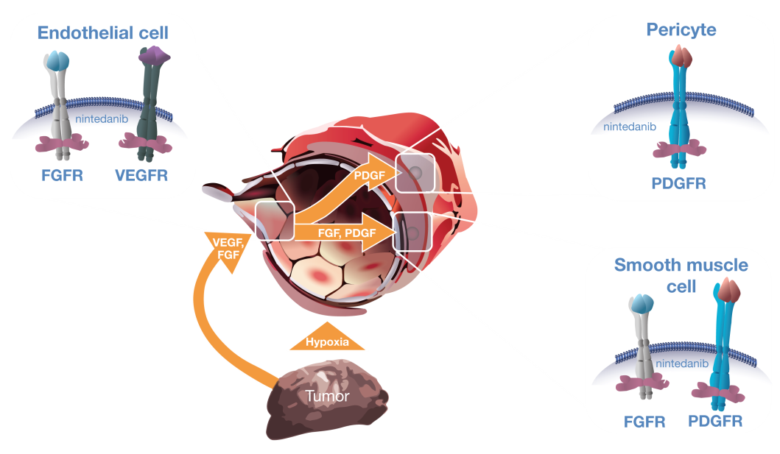
Characteristics of Nintedanib
Nintedanib is an oral, triple angiokinase inhibitor of VEGFR 1-3, PDGFR-α and -β, and FGFR 1-3, as well as RET, Flt3 and Src¹
Nintedanib in combination with docetaxel has been approved in the European Union for treatment of patients with advanced NSCLC of adenocarcinoma tumor histology after first-line chemotherapy
Nintedanib has been approved by the FDA for treatment of patients with idiopathic pulmonary fibrosis
1. Hilberg F, et al. Cancer Res. 2008;68(12):4774-4782.
FDA, Food and Drug Administration; FGFR, fibroblast growth factor receptor; NSCLC, non-small cell lung cancer; PDGFR, platelet-derived growth factor receptor; VEGFR, vascular endothelial growth factor receptor
Palmer DH, et al. J Clin Oncol. 2015;33(suppl 3): Abstract 238.

Slide 4
Angiogenesis Inhibition in HCC
HCC tumors are generally hypervascularized, suggesting that they may be vulnerable to angiogenesis inhibition
Sorafenib – an inhibitor of VEGFR 1-3 and PDGFR-β, as well as Raf kinases – is a recommended first-line treatment for patients with advanced HCC¹
However, the benefit of sorafenib in clinical trials was transient and disease progression occurred in all patients,^{2,3} suggesting a continued need for new therapies
This randomized, multicenter, open-label, phase II study (NCT01004003; 1199.37) evaluated the efficacy and safety of nintedanib versus sorafenib in predominantly Caucasian patients with advanced HCC
1. NCCN Guidelines: Hepatobiliary Cancers (2013). http://www.nccn.org. Accessed: November 13, 2014. 2. Llovet JM, et al. N Engl J Med. 2008;359(4):378-390. 3. Cheng AL, et al. Eur J Cancer. 2012;48(10):1452-1465.
OS, overall survival
Palmer DH, et al. J Clin Oncol. 2015;33(suppl 3): Abstract 238.

Slide 5
Study Design: Randomized, Open-Label, Parallel-Group Phase II Study
RANDOMI
ZE
Nintedanib
(200 mg bid continuously)
N = 62
PD
Patients with unresectable or metastatic HCC
No previous systemic anticancer treatment
2:1
Sorafenib (400 mg bid continuously)
N = 31
PD
Primary endpoint: TTP by central review according to RECIST 1.0
Secondary endpoints: OS and PFS and objective response by central independent review according to RECIST
Additional evaluations: Safety; TTP by investigator assessment (sensitivity analysis)
Stratification factors: macrovascular invasion and/or extrahepatic spread versus no invasion or spread
bid, twice daily; PFS, progression-free survival; RECIST, Response Evaluation Criteria In Solid Tumors; TTP, time to progression; PD, disease progression.
Palmer DH, et al. J Clin Oncol. 2015;33(suppl 3): Abstract 238.

Slide 6
Key Eligibility Criteria
Histologically/cytologically confirmed HCC not amenable to curative surgery or locoregional therapy
≥1 untreated, measurable lesion
ECOG PS ≤2
Child-Pugh score 5-6 (Class A)
ALT or AST levels ≤2 × upper limit of normal
>4 weeks since most recent local therapy
No prior systemic therapy for HCC
No history of other malignancy within the past 3 years and life expectancy ≥12 weeks
ALT, alanine aminotransferase; AST, aspartate aminotransferase; ECOG PS, Eastern Cooperative Oncology Group performance score;
Palmer DH, et al. J Clin Oncol. 2015;33(suppl 3): Abstract 238.

Slide 7
Patient Disposition
Patients enrolled, n = 132
Patients not randomized, n = 39
Patients randomized, n = 93
Nintedanib, n = 62
Sorafenib, n = 31
Treated, n = 62
Treated beyond progression, n = 20 (32.3%)
Treated, n = 31
Treated beyond progression, n = 10 (32.3%)
Discontinued, n = 60 (96.8%)
PD, n = 39 (62.9%);
AEs, n = 21 (33.9%); Refused to take study medication, n = 0
On trial medication at data cut-off*, n = 2 (3.2%)
Follow-up for OS at data
cut-off*,
n = 13 (21.0%)
Discontinued,
n = 30 (96.8%)
PD, n = 22 (71.0%);
AEs, n = 6 (19.4%);
Refused to take study medication, n = 2 (6.5%)
On trial medication at data cut-off*, n = 1 (3.2%)
Follow-up for OS at data cut-off*, n = 4 (12.9%)
*At cutoff date: July 15, 2014. Treatment beyond RECIST progression was allowed at the investigator’s discretion
AE, adverse event
Palmer DH, et al. J Clin Oncol. 2015;33(suppl 3): Abstract 238.

Slide 8
Baseline Characteristics
 |  | Nintedanib (n = 62) | Sorafenib (n = 31)
Mean age, years (range) |  | 65.4 (34-86) | 63.1 (28-83)
Male, n (%) |  | 48 (77.4) | 26 (83.9)
Etiology of parenchymal liver disease, n (%) | Alcohol-related Hepatitis B Hepatitis C Unknown/Other | 10 (16.1) 4 (6.5) 13 (21.0) 35 (56.5) | 3 (9.7) 7 (22.6) 8 (25.8) 13 (41.9)
Child–Pugh score, n (%) | 5 6 7* | 42 (67.7) 19 (30.6) 1 (1.6) | 23 (74.2) 8 (25.8) 0
Presence of EHS, n (%) |  | 40 (64.5) | 21 (67.7)
Presence of MVI, n (%) |  | 22 (35.5) | 9 (29.0)
Stratification group, n (%) | MVI, EHS, or both present MVI and EHS absent | 49 (79.0) 13 (21.0) | 23 (74.2) 8 (25.8)
*One patient in the nintedanib arm with a Child–Pugh score of 7 was a protocol deviation
EHS, extrahepatic spread; MVI, macrovascular invasion
Palmer DH, et al. J Clin Oncol. 2015;33(suppl 3): Abstract 238.

Slide 9
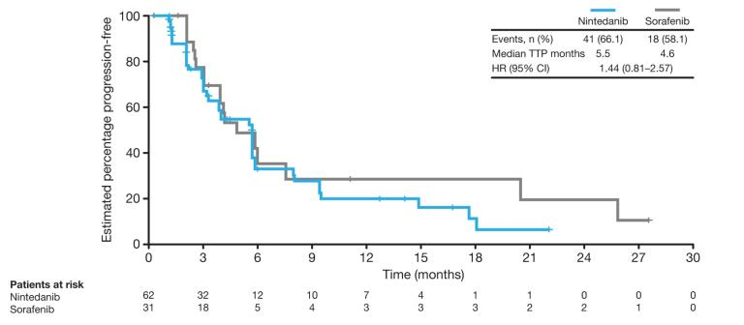
Primary Endpoint: Time-to-Progression (TTP) (Central Review)
According to RECIST 1.0
CI, confidence interval; HR, hazard ratio
Palmer DH, et al. J Clin Oncol. 2015;33(suppl 3): Abstract 238.

Slide 10
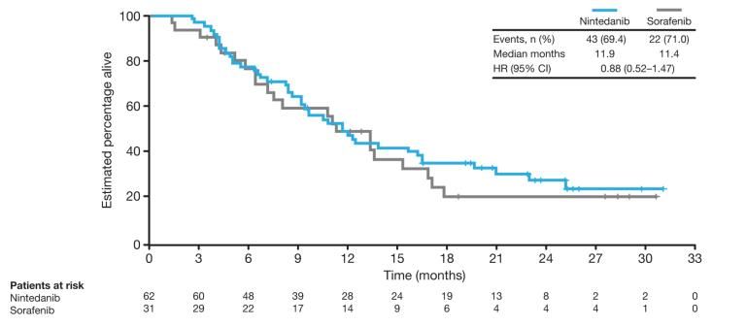
Overall Survival
Palmer DH, et al. J Clin Oncol. 2015;33(suppl 3): Abstract 238.

Slide 11
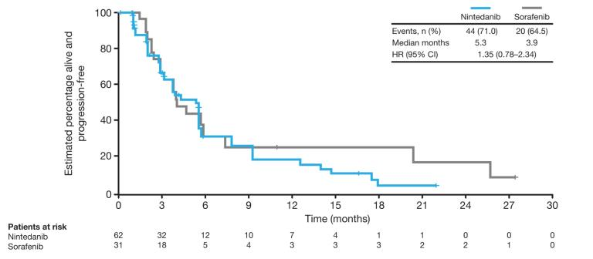
Progression-Free Survival (Central Review)
According to RECIST 1.0
Palmer DH, et al. J Clin Oncol. 2015;33(suppl 3): Abstract 238.

Slide 12
Best Overall Tumor Response (Central Review)
RECIST response, n (%) | Nintedanib (n = 62) | Sorafenib (n = 31)
Disease control | 51 (82.3) | 28 (90.3)
Objective response | 1 (1.6) | 2 (6.5)
Complete response | 0 | 0
Partial response | 1 (1.6) | 2 (6.5)
Stable disease | 50 (80.6) | 26 (83.9)
Disease progression | 8 (12.9) | 1 (3.2)
Not evaluable/unknown | 3 (4.8) | 2 (6.5)
Tumor response by independent central review according to RECIST version 1.0
Palmer DH, et al. J Clin Oncol. 2015;33(suppl 3): Abstract 238.

Slide 13
Overall Summary of AEs
Patients with AEs, n (%) |  | Nintedanib (n = 62) | Sorafenib (n = 31)
Any AE* |  | 62 (100) | 31 (100)
Drug-related AE |  | 54 (87.1) | 30 (96.8)
AE leading to dose reduction |  | 12 (19.4) | 13 (41.9)
AE leading to drug discontinuation |  | 28 (45.2) | 7 (22.6)
Any serious AE |  | 34 (54.8) | 14 (45.2)
Worst CTCAE grade | Grade 1 Grade 2 Grade 3 Grade 4 Grade 5** | 8 (12.9) 12 (19.4) 26 (41.9) 7 (11.3) 9 (14.5) | 1 (3.2) 2 (6.5) 24 (77.4) 1 (3.2) 3 (9.7)
*Median duration of nintedanib or sorafenib treatment was similar (164.5 vs 165.0 days); **All deaths were related to disease progression except for one in the nintedanib arm, which was due to interstitial lung diseaset; CTCAE, Common Terminology Criteria for Adverse Events
Palmer DH, et al. J Clin Oncol. 2015;33(suppl 3): Abstract 238.

Slide 14
Most Frequent AEs (≥20% in Either Study Arm)
Patients with AEs, n (%) | Nintedanib (n = 62) | Sorafenib (n = 31)
Diarrhea | 44 (71.0) | 21 (67.7)
Fatigue* | 38 (61.3) | 17 (54.8)
Nausea | 30 (48.4) | 9 (29.0)
Vomiting | 24 (38.7) | 9 (29.0)
Decreased appetite | 23 (37.1) | 13 (41.9)
Abdominal pain | 16 (25.8) | 9 (29.0)
Upper abdominal pain | 16 (25.8) | 4 (12.9)
Rash | 6 (9.7) | 7 (22.6)
Alopecia | 3 (4.8) | 11 (35.5)
Palmar–plantar erythrodysesthesia syndrome | 1 (1.6) | 11 (35.5)
By preferred term
*Group term includes fatigue, lethargy, asthenia and malaise
Palmer DH, et al. J Clin Oncol. 2015;33(suppl 3): Abstract 238.

Slide 15
AEs of Grade ≥3 (≥5% in Either Study Arm)
Patients with AEs, n (%) | Nintedanib (n = 62) | Sorafenib (n = 1)
Diarrhea | 8 (12.9) | 1 (3.2)
Fatigue* | 7 (11.3) | 2 (6.5)
Increased AST | 7 (11.3) | 1 (3.2)
Increased ALT | 5 (8.1) | 2 (6.5)
Hepatic encephalopathy | 5 (8.1) | 1 (3.2)
Anemia | 4 (6.5) | 1 (3.2)
Malignant neoplasm progression | 2 (3.2) | 3 (9.7)
Thrombocytopenia | 1 (1.6) | 3 (9.7)
Skin reaction | 1 (1.6) | 2 (6.5)
Palmar–plantar erythrodysesthesia syndrome | 0 | 7 (22.6)
By preferred term
*Group term includes fatigue, lethargy, asthenia and malaise; ALT, alanine aminotransferase; AST, aspartate aminotransferase
Palmer DH, et al. J Clin Oncol. 2015;33(suppl 3): Abstract 238.

Slide 16
AEs Frequently Associated With VEGF/VEGFR Inhibitors
Patients with AEs, n (%) | Nintedanib (n = 62) |  | Sorafenib (n = 31)
 | All grades | Grade ≥3 | All grades | Grade ≥3
Bleeding | 18 (29.0) | 5 (8.1) | 7 (22.6) | 0
Specific liver-related investigations (tailored)* | 15 (24.2) | 11 (17.7) | 8 (25.8) | 4 (12.9)
Rash | 13 (21.0) | 2 (3.2) | 12 (38.7) | 4 (12.9)
Hypertension | 9 (14.5) | 2 (3.2) | 3 (9.7) | 1 (3.2)
Cutaneous serious skin reactions | 3 (4.8) | 0 | 6 (19.4) | 2 (6.5)
Thromboembolic events** | 1 (1.6) | 1 (1.6) | 4 (12.9) | 2 (6.5)
GI perforations | 0 | 0 | 1 (3.2) | 1 (3.2)
By group term
*Reported events included increased aspartate aminotransferase, increased blood bilirubin, increased alanine aminotransferase, jaundice, hyperbilirubinaemia, increased hepatic enzyme and increased transaminases; **No arterial thromboembolism events were reported
Palmer DH, et al. J Clin Oncol. 2015;33(suppl 3): Abstract 238.

Slide 17
Conclusions
Nintedanib showed similar efficacy to sorafenib with respect to TTP by central review, OS, PFS, and OR by central review
A manageable safety profile was observed with nintedanib
Diarrhea, fatigue, nausea, vomiting, and upper abdominal pain were reported more frequently with nintedanib than with sorafenib
Decreased appetite, abdominal pain, rash, alopecia, and palmar–plantar erythrodysesthesia syndrome were more frequent with sorafenib than with nintedanib
Further studies of nintedanib in patients with advanced HCC are warranted
Palmer DH, et al. J Clin Oncol. 2015;33(suppl 3): Abstract 238.

